Slide 1

FAN SPEED CONTROLLER
201EC166 – JEEVANANTHAM L
Under guidance of
201EC186 – LOGESH R
Dr.B.GOLDVIN SUGIRTHA DHAS,
201EC189 – MAHESH KUMARAN A
Assistant Professor (EEE),
201EC282 – VENKATESH V
BIT , SATHY.

Slide 2
FAN SPEED CONTROLLER
ABSTRACT:
This project is an automatic fan speed controller that controls the speed of an electric fan according to the requirements. Arduino board is very progressive among all controller circuits, thus we employed Arduino board for fan speed control. The proposed framework is used to determine the temperature and humidity of the room and send that data to the Arduino board. At that point the Arduino board executes the temperature dependent on the inbuilt program and helps in movement of fan. The main reason to use this controller is it does not require any fan regulator and physical contact with it.
The thermal comfort of the person at a particular place depends on temperature and humidity. This project proposes an automatic fan speed controller based on temperature and humidity. The proposed system takes in the temperature and humidity and predicting the required fan speed. A neural network is created based on the relation between the temperature, humidity and airspeed obtained from the CBE Thermal Comfort Tool for ASHRAE-55. The predicted airspeed is fed to the ceiling fan through the driver circuit. The system is implemented using the ATmega328 microcontroller.

Slide 3
PROBLEM STATEMENT:
Modern electronics has provided the consumer with the ability to remotely control a variety of household appliances. However, there has not yet been exploited with automatic control of ventilation devices, or more particularly to the control of fan’s speed. In operation to control speed a fan, it is often necessary to physically adjust the fan in order to increase the degree of ventilation provided, or substantially change the direction of air flow. The ability to automatically change the speed of fan via changes of surroundings temperature would allow the user to feel comfort without physically to change the speed of fan. The automatic control of this operation would further aid in the use of such a fan by those who are sick, handicapped or elderly. Moreover, this ARDUINO based ceiling fan is as further step to improve the technology of a fan. This new invention will satisfy a person needs to make life easier and better. All the mundane household chores are done without having to think about those works.
SOLUTION:
The temperature-based fan speed control system can be done by using an electronic circuit using an Arduino board. Now Arduino board is very progressive among all electronic circuits, thus we employed Arduino board for fan speed control .The proposed system is designed to detect the temperature of the room and send that information to the Arduino board. Then the Arduino board executes the contrast of current temperature and set temperature based on the inbuilt program of the Arduino. The outcome obtained from the operation is given through the o/p port of an Arduino board to the LCD display of related data. The generated pulses from the board which is further fed to the driver circuit to get the preferred output to the fan. The proposed system takes in the temperature and humidity and predicting the required fan speed. A neural network is created based on the relation between the temperature, humidity and airspeed obtained from the CBE Thermal Comfort Tool for ASHRAE-55

Slide 4
WORKING:
The working can be divided into four different parts. They are as follows
Zero-Crossing Detector
Phase Angle Controlling circuit
Potentiometer to control the Fan speed amount
PWM signal Generation circuit
Zero-Crossing Detector
The AC supply we get in our household is 220v AC RMS, 50 HZ. This AC signal is alternating in nature and changes its polarity periodically. In the first half of every cycle, it flows in one direction reaching a peak voltage and then decreases down to zero. Then in the next half-cycle, it flows in alternate direction (negative) to a peak voltage and then again comes to zero. For controlling the speed of AC Fan, the peak voltage of both the half cycles needs to be chopped or controlled. For this, we must need to detect the zero point from which the signal is to be controlled/Chopped. This point on the voltage curve where the voltage changes the direction is called zero voltage crossing.
Phase Angle controlling Circuit
After detecting the point of zero crossing, now we have to control the amount of timing for which the power will be ON and OFF. This PWM signal will decide the amount of voltage output to the AC motor, which in turn controls the speed of it. Here a BT136 TRIAC is used, which controls the AC voltage as it is a power electronic switch for controlling an AC voltage signal.
TRIAC is a three-terminal AC switch that can be triggered by a low energy signal at its gate terminal. In SCRs, it conducts in only one direction, but in the case of TRIAC, the power can be controlled in both directions.
Potentiometer to control the Fan Speed
Here a potentiometer is used to vary the speed of AC Fan. We know that a potentiometer is a 3 terminal device that acts as a voltage divider and provides a variable voltage output. This variable analog output voltage is given at the Arduino analog input terminal to set the speed value of the AC fan.
PWM Signal Generation Unit
In the final step, a PWM pulse is given to the TRIAC as per the speed requirements, which in turn varies the ON/OFF timing of the AC signal and provides a variable output to control the Fan speed. Here Arduino is used to generate the PWM pulse, which takes the input from the potentiometer and gives PWM signal output to TRIAC and optocoupler circuit which further drives the AC fan at the desired speed. Learn more about PWM generation using Arduino here.

Slide 5
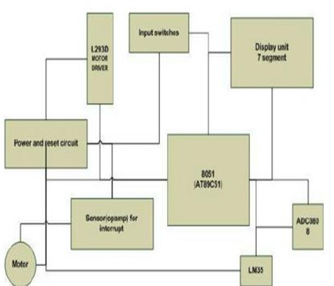
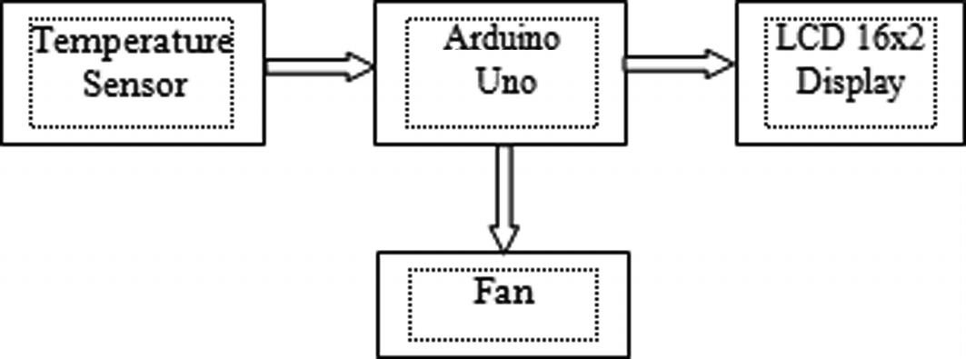
FLOW CHART:
BLOCK DIAGRAM:

Slide 6
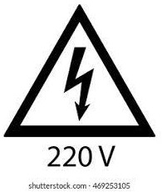
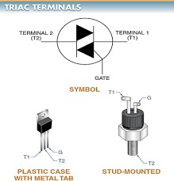
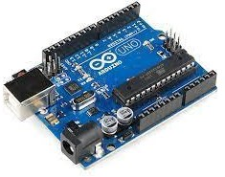
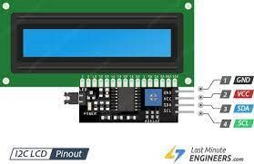
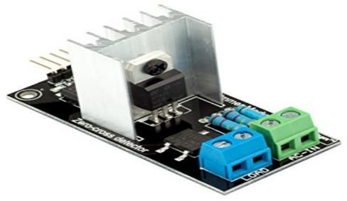
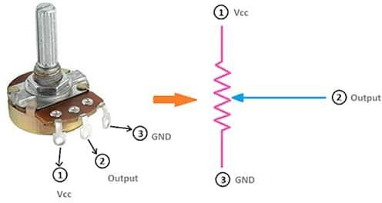
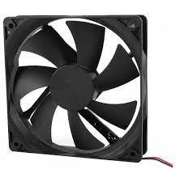
TECHNOLOGY STACK:

Slide 7
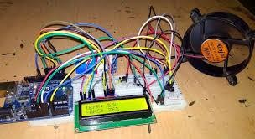
SAMPLE OUTPUT MODEL:
COST BENEFIT ANALYSIS:
COMPONENTS | SPECIFICATION | COST
Arduino | UNO | 350
Sensors | TRIAC, AC DIMMER | 500
LCD | I²C | 250
FAN | DC FAN | 300
TRANSFORMER | 220 V TO 5 V | 100

Slide 8
REFERENCE:
Liu, Y., Zeng, J. and Wang, C. (2009). Temperature Monitoring in Laser Assisted Polymer Bonding for MEMS Packaging Using a thin Film Sensor Array , IEEE Sensors Applications Symposium, New Orleans, LA , USA.
Jung, W.,You, J. and Won, S. (2008). Temperature Monitoring System for Inductive Heater Oven (pp.1734-1737), International Conference on Control, Automation and Systems, Seoul Korea.
Chiueh, H., Choma, J. and Draper, J. (2000). Implementation of a temperature Monitoring Interface Circuit for Power PC Systems (pp.98-101), Proceedings of the 43rd Midwest Symposium on Circuits and Systems, Lansing MI, USA.
Mehta V. K and Mehta R. (2007). Principle of Electronics, S.Chand & Company Ltd.New Delhi, 438
Theraja B. L and Theraja A. K. (2002). A Textbook of Electrical Technology, S. Chand &Company Ltd. New Delhi, 2105

